Slide 1
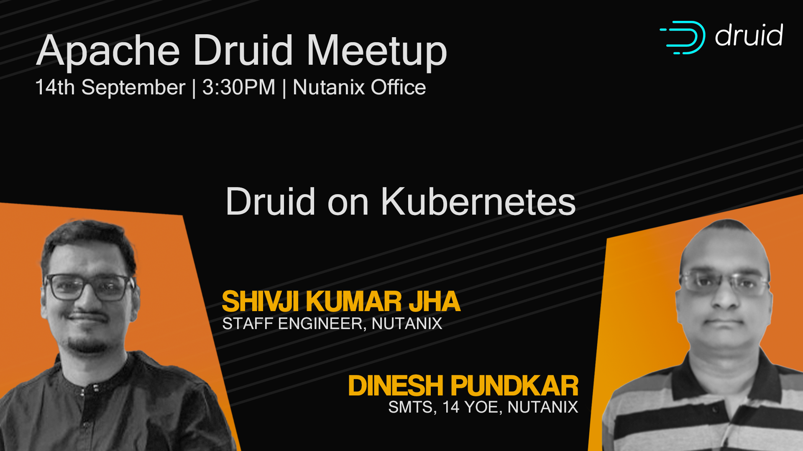

Slide 2
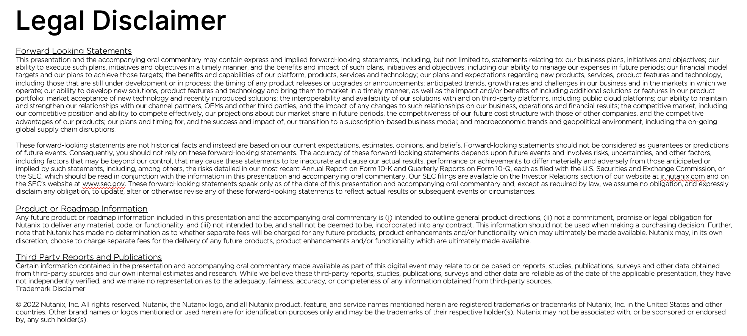

Slide 3





Shivji Kumar Jha
Staff Engineer at Nutanix
linkedin.com/in/shivjijha/
slideshare.net/shiv4289
youtube.com/@shivjikumarjha
Dinesh Pundkar
SMTS at Nutanix
linkedin.com/in/dineshqa
Staff Engineer, Cloud Data Platforms at Nutanix
Regular Software Developer
Excited about:
Distributed Systems
Databases & Streaming
Open Source Software
Lately talking to OSS communities..
SMTS, CPaaS Team at Nutanix
14+ Years of Experience
Multi-faceted
Loves Infrastructure (Cloud, Datacenter, Kubernetes)
Decade of experience with Apps, Infra and Cloud!

Slide 4
Contents
Why Analytical Databases?
Druid Primer & Components
What We Love About Druid
Numbers from 3+ years in Prod
Kubernetes Primer
Druid on Kubernetes
D-Day : The Migration
Challenges & Learnings

Slide 5

Show of Hands
Have you used an analytics database?
Have you used Druid?
Other Analytics Databases?
Kubernetes in production environment?

Slide 6
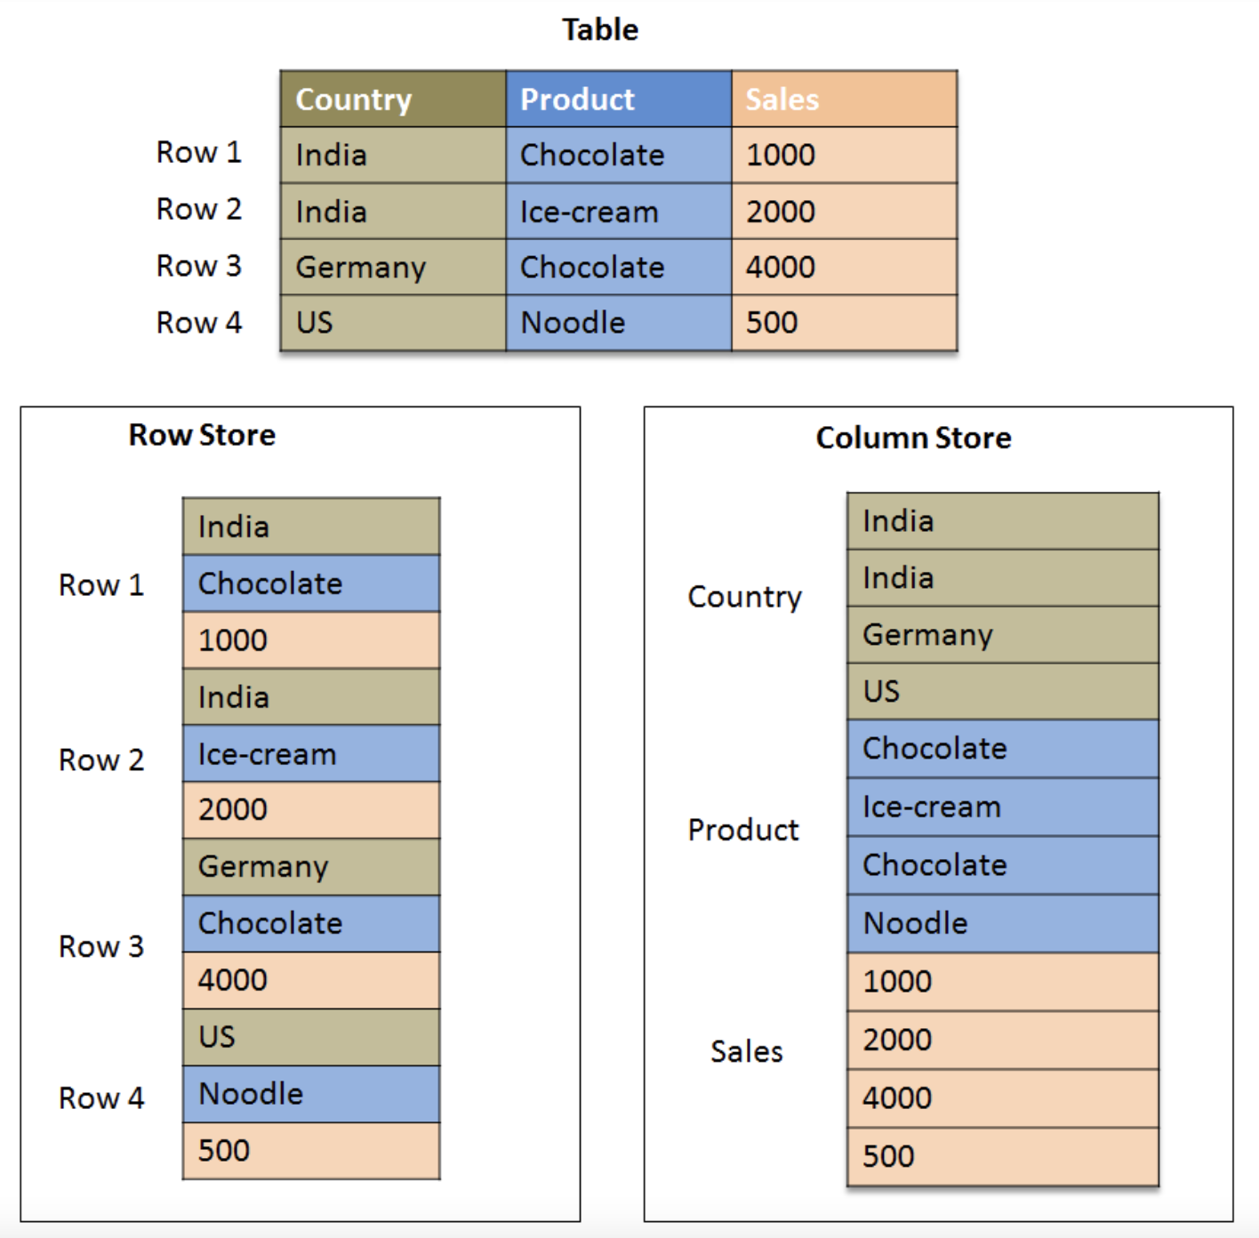
Analytical Databases
Analytical Databases
Columnar databases
Snowflake
Redshift
BigQuery
Druid
ClickHouse
Pinot
Row vs Columnar Storage

Slide 7





Druid 101
Open-source, Apache 2.0 License and under Apache Foundation
Columnar data store designed for high-performance. Supports Real-time and Batch ingestion.
Segment Oriented Storage
Distributed and modular architecture, horizontally scalable for most parts
Supports Data tiering – Keep cold data in cheaper storage!

Slide 8




What we love about Druid!
Modularity - Separation of Concerns
Modularity – Simplicity* : Ease to deploy , Upgrade, Migrate, Manage
Modularity – Flexibility - Scale only what you need, Retain based on retention rules on tiers
Modularity - Built for Cloud
Durability – Object Store (S3 or Nutanix Objects for instance) for Deep Storage
Durability - SQL database for metadata
Admin Dashboard – easier debugging and monitoring

Slide 9


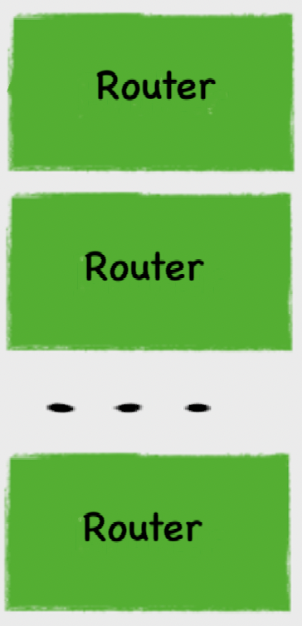



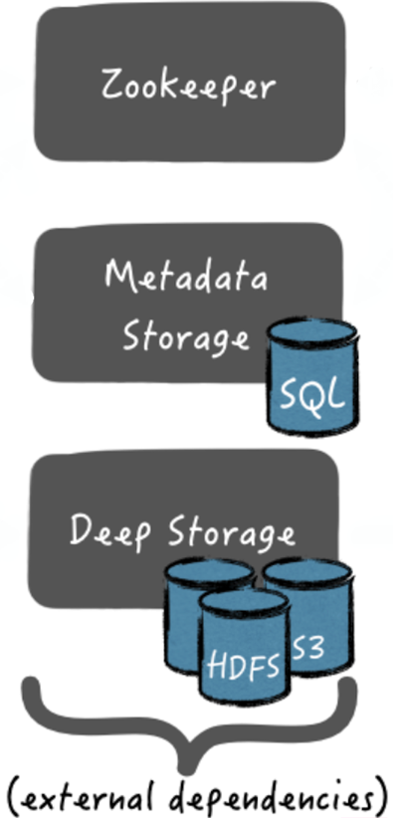
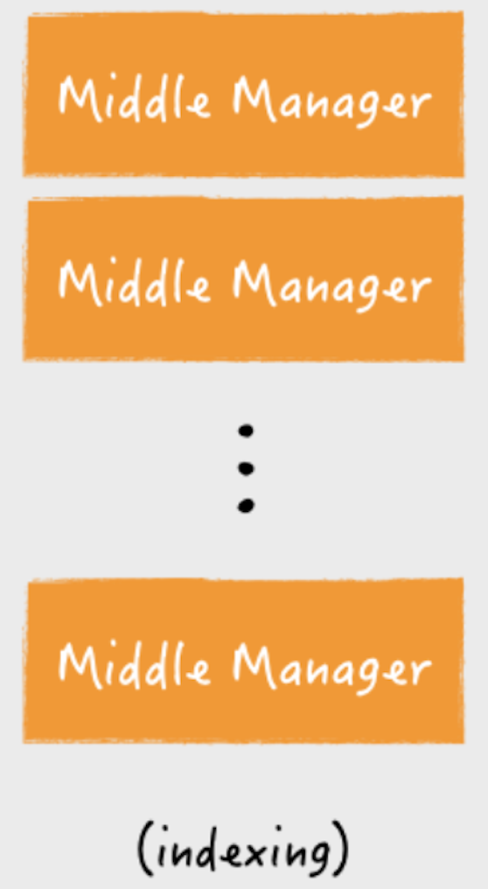
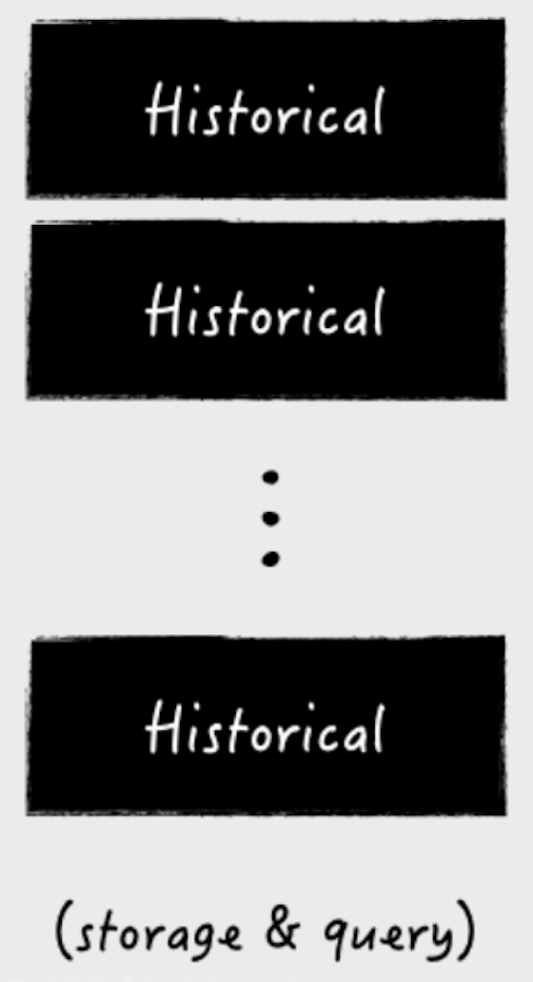
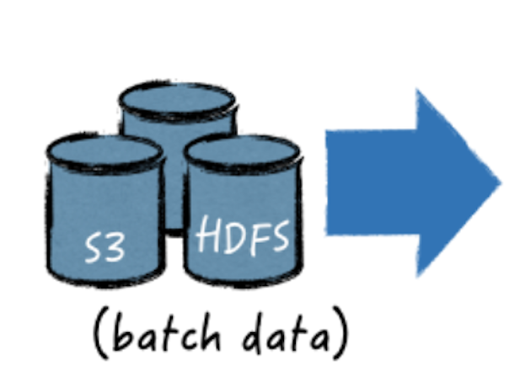
Druid Architecture
Read
Write

Slide 10
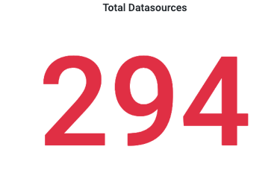
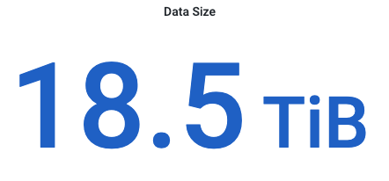
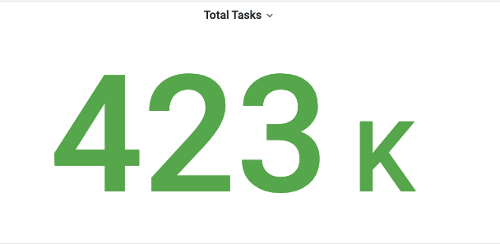

Numbers running Druid 3+ years in Prod
Cluster Size
Last 24 hours

Slide 11
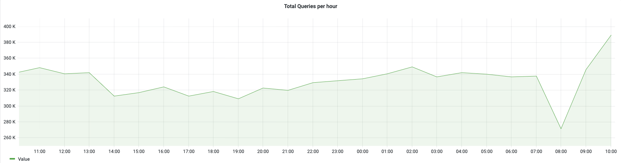
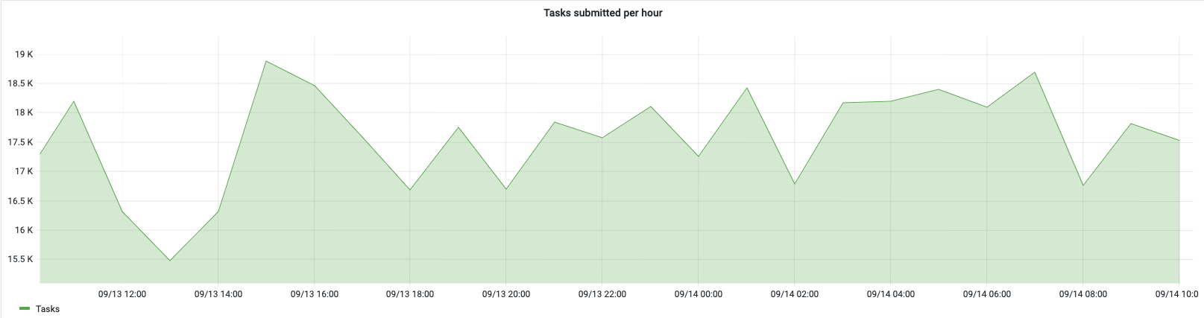

Slide 12
Why Kubernetes?
Earlier Deployment
Nomad + Consul on AWS
Metadata Storage – Postgres RDS
Deep Store – S3 Buckets
Why we decided to move to Kubernetes
Nutanix Kubernetes Engine and other internal dev on Kubernetes
More adoption means better ecosystem
Apache 2.0 License & CNCF Graduated Project.
Stateful sets, helm/operator available for Druid
Well… easier to hire and scale the team!
Current Deployment
Kubernetes Cluster
Self managed with kOps, deployed on AWS
Used Open-source Druid HELM Charts
GitOps Deployment model using Helm Charts backed by ArgoCD

Slide 13




A Quick Kubernetes Primer
StatefulSet - Manage a set of Pods with unique identities and persistent storage.
DaemonSet - Ensure all nodes run a copy of a Pod.
Persistent Vol (PV) & Persistent Vol Claim(PVC) – Persistent Storage
ConfigMap - Store non-confidential configuration data in key-value pairs
Init-Container - Containers that run before the application containers in a Pod
Secrets - Store non-confidential configuration data in key-value pairs

Slide 14
Druid - Kubernetes Mapping
Druid Components | Type
Router + Broker + Co-Ordinator + Overlord | Deployment
Middle-Managers | DaemonSet
Historical | StatefulSet
Deep Storage | S3 Bucket
Metadata Storage | Postgres RDS
Zookeeper | StatefulSet

Slide 15
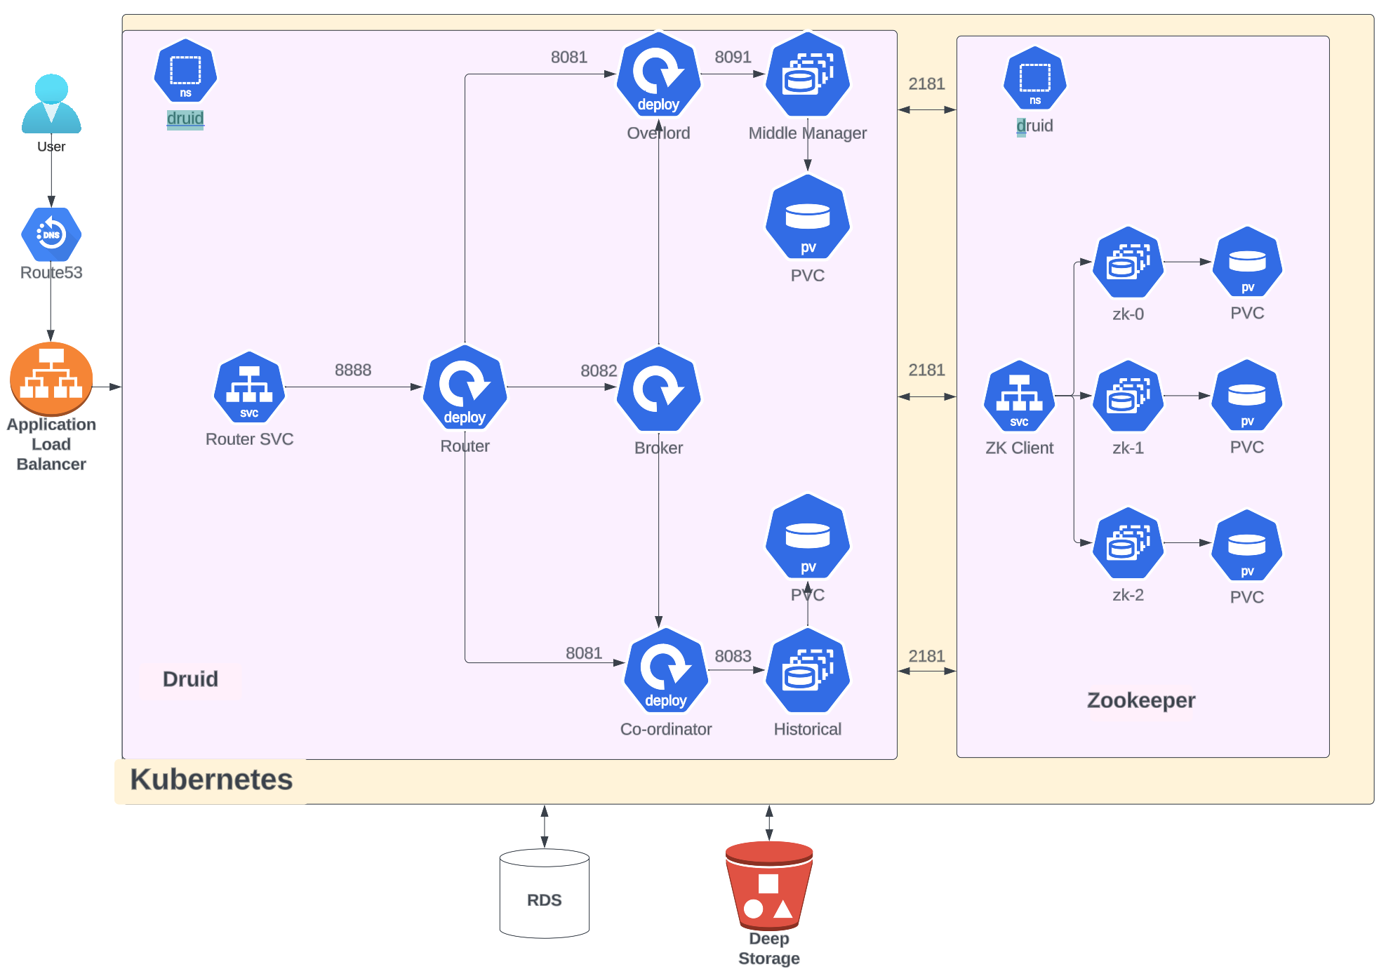
Druid on Kubernetes Architecture

Slide 16

D-Day : The Migration Process!
Existing Setup
New Setup
Temp S3 Bucket
Preparation Phase
Druid on Nomad
S3 Bucket
Druid on K8s
Data Sync Phase
Temp PgSQL RDS
Cut Over Phase
Postgres RDS
ZK
ZK

Slide 17
Operational Aspects
Upgrades
App
Infrastructure
Reliability
Minimum 2 Replicas for each component
Spread across AZs
Scalability
Multiple ways to auto-scale Druid components
Horizontal Pod Autoscaler (HPA)
Auto-scaling groups with DaemonSets
Security
Image Scanning
Secret Management Store

Slide 18
Challenges & Learnings
Must scale Overlord & Coordinator vertically, no support for horizontal scaling!
Keep track of
Size of task spec payload (Znode size limits)
Number of Segments
Files in task specs (don’t use prefix-based)
Issues with Calcite query planner on upgrades
Suggest to upgrade one version at a time
Too many components:
More maintenance
Steep Learning Curve
Too many components for tiny workloads
Separation of compaction tier?
Can’t differentiate between sub task type when partitionSpec is dynamic for index parallel and compact parallel
Play around Kubernetes Stateful sets, Kubernetes infra upgrades etc.

Slide 19
References
Druid Docs are amazing!
Druid WhitePaper – a great read on modularity and distributed systems
Druid Helm Charts and Operator – for how-to's on Kubernetes.

Slide 20


The real Druid “Rockstars”!
Sachidananda Maharana
MTS 4 Nutanix
Bharadwaj R Embar
SMTS Nutanix

Slide 21



Questions ?
Ask the Druid Community
druid.apache.org/community/join-slack?v=1
lists.apache.org/list.html?dev@druid.apache.org
twitter.com/druidio
Contact Speakers
Shivji Kumar Jha
Staff Engineer at Nutanix
linkedin.com/in/shivjijha/
slideshare.net/shiv4289
youtube.com/@shivjikumarjha
Dinesh Pundkar
SMTS at Nutanix
linkedin.com/in/dineshqa

